Slide 1
InfoPath 2007 and Forms Services
Capturing User Input through Electronic Forms

Slide 2
Agenda
Background in InfoPath 2003
The InfoPath Forms Designer
Integration with WSS forms libraries
Forms Services Architecture
Designing Browser-Enabled forms with InfoPath 2007

Slide 3
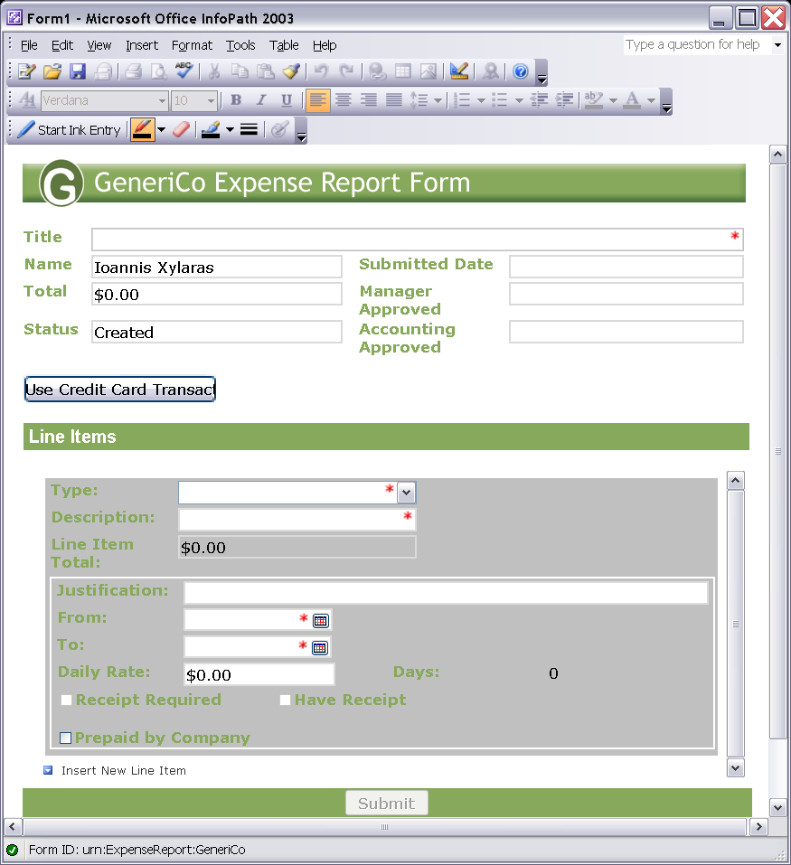
The Role of InfoPath in Office 2003
InfoPath was introduced with Office 2003
Platform for next generation of electronic forms
InfoPath Forms
Captures XML data
Based on XML Schema
Requires little/no code
Notes:
Instructor Notes
Try to figure out if the participants have experience with InfoPath – if not, take your time for this slide
Briefly review the following capabilities and how they support a portals and collaboration offering:
XML data collection
- Conditional formatting
- No coding required
Effective sharing
- Any schema
- XML Web services
Data management
- Dynamic forms
- Text formatting, AutoCorrect
- Offline and e-mail

Slide 4
Challenges with InfoPath 2003
Companies like InfoPath 2003, but…
They want better support for offline scenarios
They want to greater reach (browser-based clients)
They want a better code-behind model
InfoPath 2007 introduces several improvements
Improved offline support through wizard
Forms Services extended InfoPath forms to browser
IT People Responsible for the Deployment
Code-behind using Visual Studio Tools Applications
Notes:
Instructor Notes
Go slowly over the bullets
Reach more users -> today you need to have InfoPath on the desktop before you can fill in the forms talk about for example a government agency who wants to use electronic forms and want to reach more users
Off-line capabilities -> possible with InfoPath 2003 but requires coding
Integration -> use example of Outlook -> InfoPath forms are provided as attachments, not very well integrated
Hosting InfoPath in your own custom solutions
Vbscript and javascript are there out of the box, .NET can be used if you download the InfoPath Toolkit for Visual Studio.NET
Integrate better with back-end systems – e.g. instead of having the connection details inside the template, let’s store it outside of the template

Slide 5



Security – Trust Levels
Restricted
Deployed via email, no auto-updates
No data connections, no managed code
Not applicable for browser forms
Domain
Deployed to SharePoint library, browser forms
Connect to own server only, no code for browser forms
Use trusted Data Connection Library for cross-domain
Full Trust
Installed, Digitally Signed, or .NET Code Group
Must be admin-deployed for browser forms
Connect to any server, managed code in browser forms
Notes:
Instructor Notes
Depending on your deployment option, different trust levels will be active
Deployed via email → very limited permissions
Deployed in a web server (e.g. SharePoint library) → depending on your IE security settings
Deployed via installer → possibility to get full trust

Slide 6
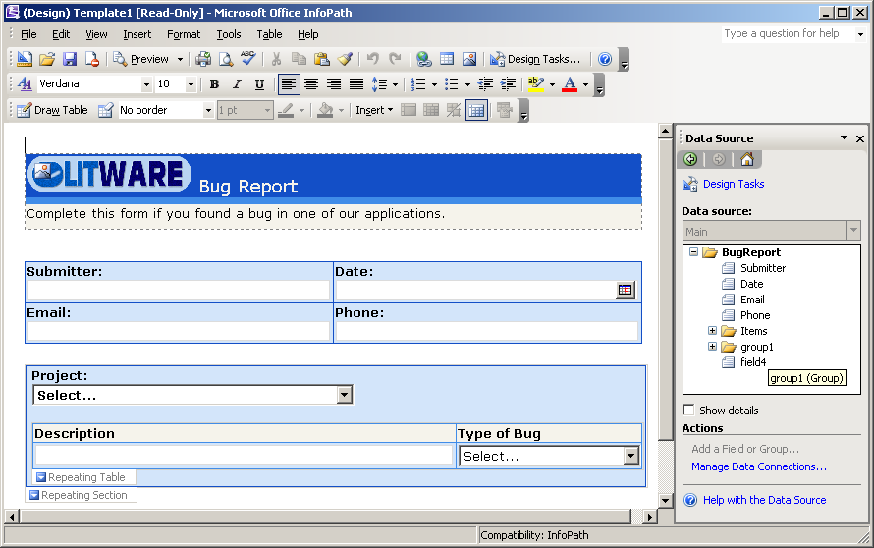
Demo: The InfoPath Forms Designer

Slide 7
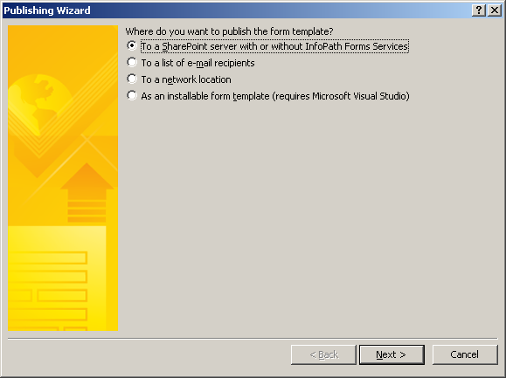
InfoPath Integration with WSS
Forms Libraries
A document library with a .XSN document template
Introduced with InfoPath 2003 and WSS 2.0
Create by users through InfoPath Publishing command

Slide 8

Template Importing
Entry Form
Word doc
Word doc Converter
New InfoPath
Entry Form
InfoPath
Designer
Built-in support for Word, Excel documents
Use in combination with the Design Checker
Notes:
Instructor Notes
In InfoPath 12, we will make it easy for people to convert Word forms into InfoPath forms. There are two goals for this area: 1) include a Word importer with InfoPath and 2) build a platform so that others can create custom converters. For the Word importer, we will make it easy to convert, say, a static Word table to a repeating table, or brackets with a single space [ ] to a check box.
The import process will even generate a schema automatically. Issues found during import will be reported in the Design Checker.
We also provide tools to “clean up” after importing – change controls from one type to another, or make tables repeating.

Slide 9
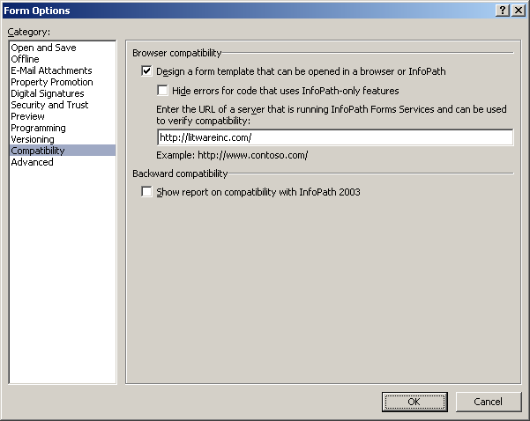
Browser-based Forms
Forms Services provides HTML rendering
Forms must be designed using InfoPath 2007
Forms must be designed to be browser compatible

Slide 10
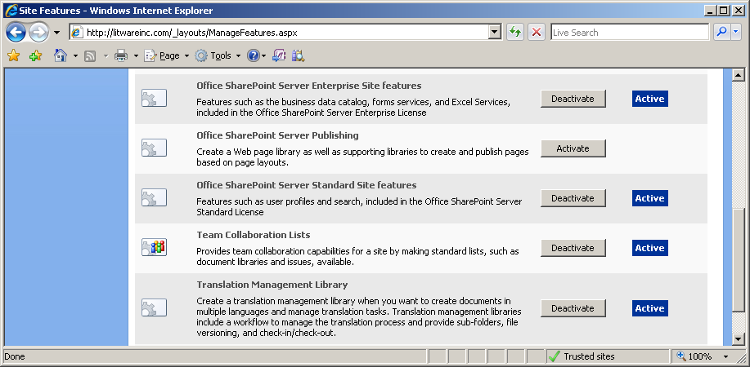
Sites and Browser-based Publishing
Activate MOSS Standard and Enterprise features
Should be done for target site and site collection
Turn this on

Slide 11
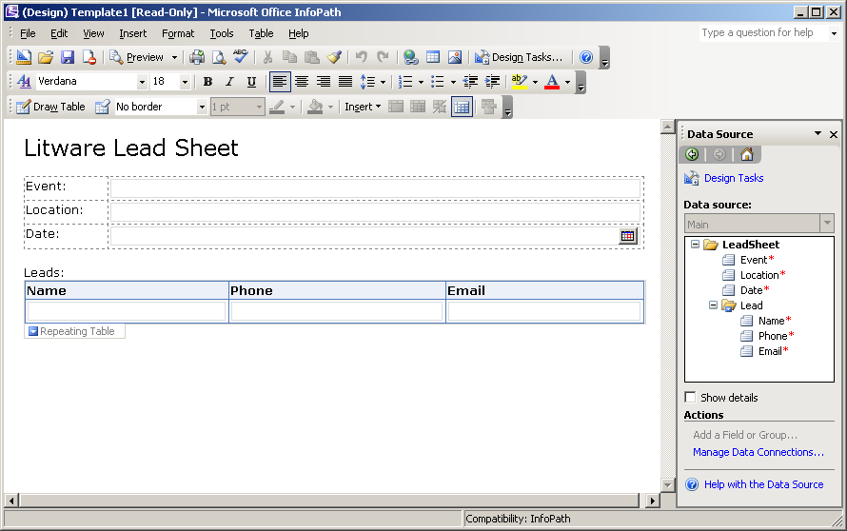
Designing a Browser-based Form
Notes:
InfoPath will automatically disable non-browser enabled features….

Slide 12
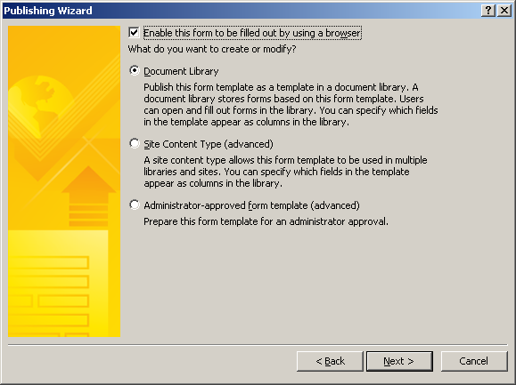
Publishing a Browser-based Form
Saved up to WSS Forms Library
MOSS uses document template .xsn file for rendering

Slide 13
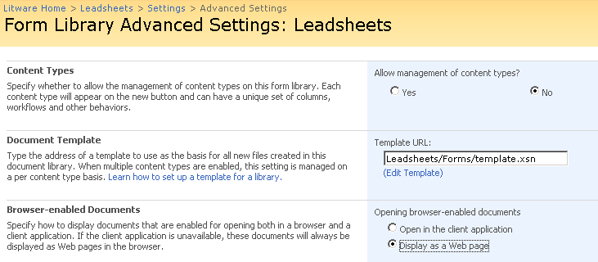
Forms Library Settings
Important Forms Library settings
template.xsn is the editable InfoPath form template
Open browser-enabled documents
The default is to open with InfoPath rich client if possible

Slide 14
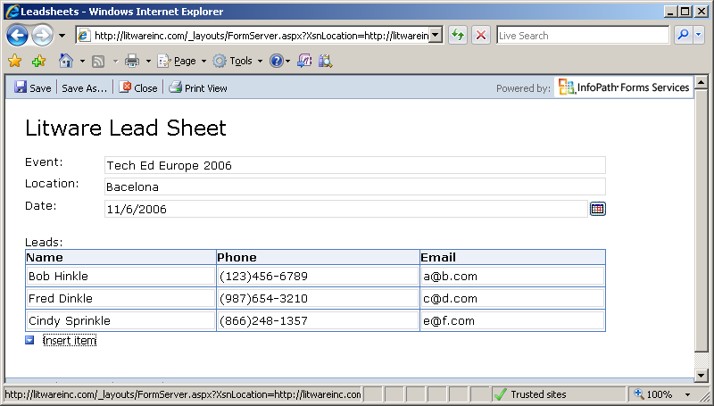
Browser-based Rendering
Browser-based rendering for wide reach
Based on DHTML and JavaScript
Tested with IE, FireFox, Netscape & hand-held devices

Slide 15
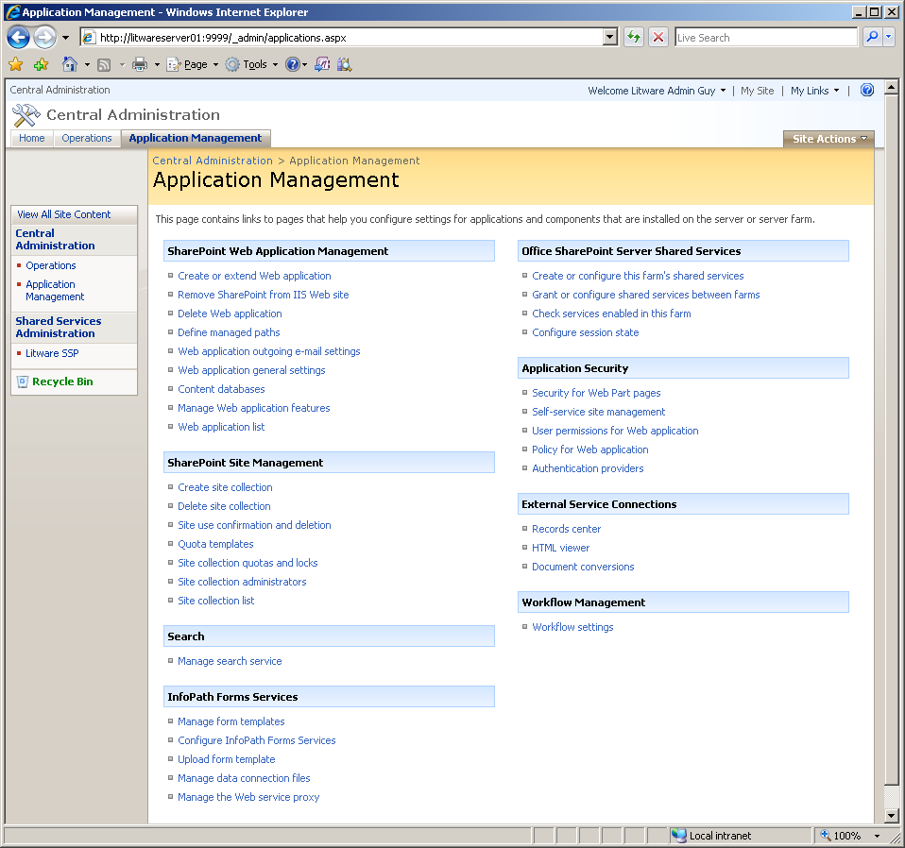
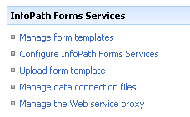
Forms Services Administration
Part of WSS Central Administration
Used to upload/manage forms and data connections

Slide 16
Summary
Background in InfoPath 2003
The InfoPath Forms Designer
Integration with WSS forms libraries
Forms Services Architecture
Designing Browser-Enabled forms with InfoPath 2007

